Slide 1
energy efficiency
by
Naveen Sanapala

Slide 2
problem statement
The effect of eight input variables (relative compactness, surface area, wall area, roof area, overall height, orientation, glazing area, glazing area distribution) on two output variables, namely heating load (HL) and cooling load (CL), of residential buildings is investigated using a statistical machine learning framework. We have to use a number of classical and non-parametric statistical analytic tools to carefully analyze the strength of each input variable's correlation with each of the output variables in order to discover the most strongly associated input variables.
We need to estimate HL and CL, we can compare a traditional linear regression approach to a sophisticated
state-of-the-art nonlinear non-parametric method, random forests.

Slide 3
tools used
Python
Pandas
Matplotlib
Seaborn
Sklearn
Github

Slide 4
approach
We will be doing thorough exploratory analysis for all the Feature columns using Matplotlib and seaborn.
We will be checking if there is any linear relationship in between feature columns and Target Variables using correlation matrix and Heatmap.
We will split the data into train and test sets using sklearn library.
We will create regression models to predict the target variables using Linear Regression and Random Forest methods and compare them.

Slide 5
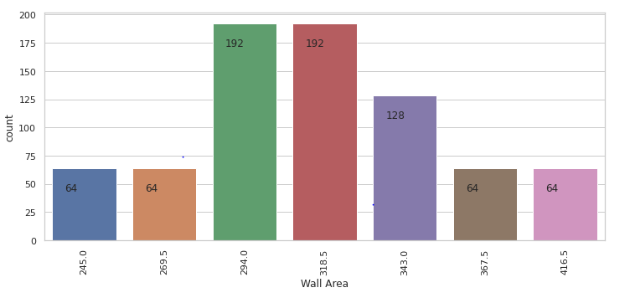
exploratory data analysis
Wall Area :

Slide 6
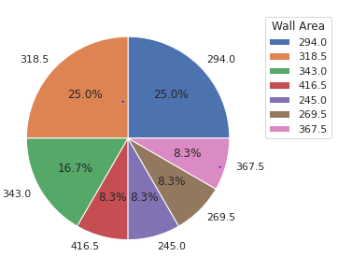
From these two figures ,we can see that around 66 percent of data is of wall Area in [294, 318.5, 343].

Slide 7
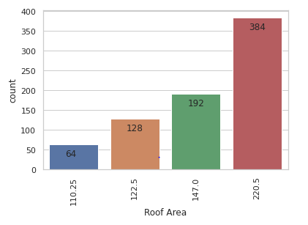
Roof Area:

Slide 8
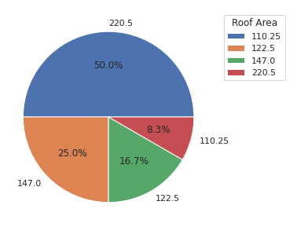
From the two figures, we can notice around 75 percent of data has 220.5 or 147 as roof Area.

Slide 9
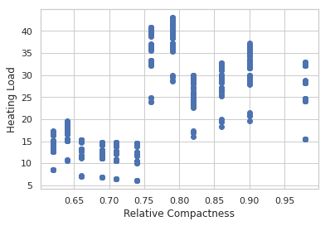
effect of features on target variables
Relative Compactness:
We can notice the changes in Heating load with respect to the change in Relative Compactness . We can notice Heating load is low till Relative Compactness reaches 0.75 . As Relative compactness increases further , Heating load is increases Tremendously.

Slide 10
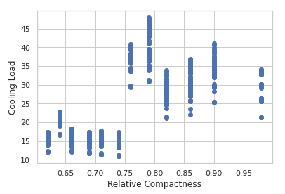
We can notice the changes in Cooling load with respect to the change in Relative Compactness . We can notice Cooling load is low till Relative Compactness reaches 0.75 . As Relative compactness increases further , Cooling load is increases Tremendously.

Slide 11
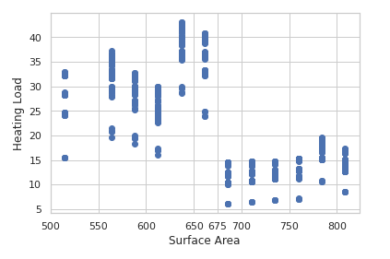
Surface Area:
We can notice Heating load is high till Surface area crosses 675, After that Heating load is low.

Slide 12
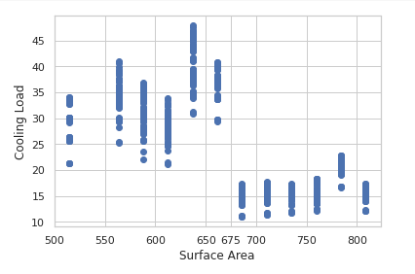
We can notice Cooling load is high till Surface area crosses 675, After that Cooling load is low.

Slide 13
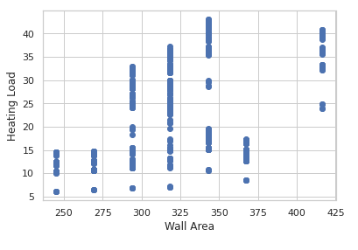
Wall Area:
We can notice increasing trend in Heating load till Wall Area becomes 350 ,after that there is a drop in heating load in between 350-375 . Heating load increased after 400.

Slide 14
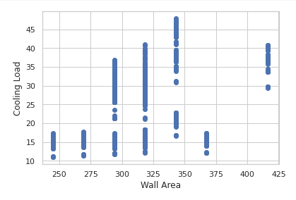
We can notice increasing trend in Cooling load till Wall Area becomes 350 ,after that there is a drop in Cooling load in between 350-375 . Cooling load increased after 400.

Slide 15
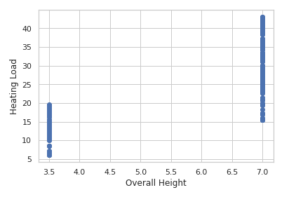
Overall Height:
We can notice an increase in Heating load with increase in Overall Height.

Slide 16
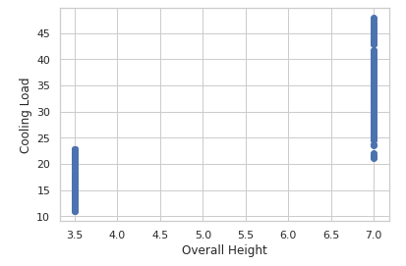
We can notice an increase in Cooling load with increase in Overall Height.

Slide 17
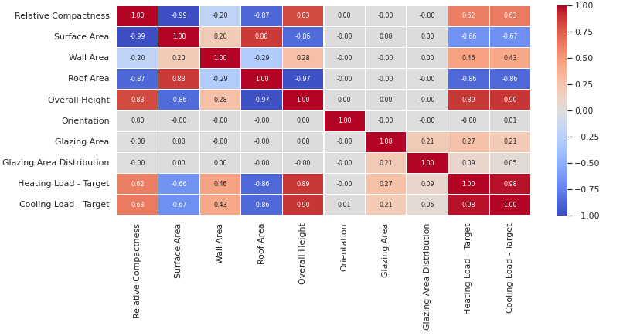
checking linear relationship using heatmap
We can notice there is not much linear relationship for Orientation , Glazing Area and Glazing Area Distribution with Heating and Cooling Loads.

Slide 18
train-test split
We split the data into Training set and Test set with a test size of 0.25 using train_test_split from sklearn.model_selection
Shapes after splitting:
X_train (576, 8)
y_train (576, 2)
X_test (192, 8)
y_test (192, 2)

Slide 19
modelling
As given in Problem statement , We will be comparing Linear regression and Random forest methods.
We will check if we can improve the performance of the Random forest model by Hyper parameter tuning.
We will compare the models using R2 score and check which model gives highest R2 score.

Slide 20
linear regression
The Linear regression model with default parameters gave an R2 score 0.901.
With the help of this model , We were able to predict Heating Load and the cooling load of residential building.
Model Coefficients:
[[-5.53981092e+01, 1.96331442e+11, -1.96331442e+11, -3.92662883e+11, 4.03265667e+00, -7.17251264e-02, 1.95219206e+01, 1.73758021e-01], [-6.33130815e+01, -3.67776248e+11, 3.67776248e+11, 7.35552497e+11, 4.27446079e+00, 1.14528313e-01, 1.46498568e+01, 9.51001048e-03]]
Model Intercepts:
[71.27289931, 85.70536458]

Slide 21
random forest regressor
Random Forest regressor model with default parameters gave an R2 score of 0.977.
Hyper Parameter Tuning:
We performed hyper parameter tuning using GridSearchCV
from sklearn.model_selection in the below search space.
'max_depth': [10, 15, 20],
'max_features': [4, 5, 6],
'n_estimators': [200, 250, 300].
Other parameters:
CV=5 and scoring =‘r2’

Slide 22
After Hyper parameter tuning we got the best parameters in search space as below:
'max_depth': 15, 'max_features': 4, 'n_estimators': 300
We got 0.981 as R2 score the Random forest model with best parameters.
On comparing the R2 scores of models, We can confirm that the Random forest model fitted with best parameters in search space performed well.

Slide 23


